Slide 1
Module 4
Functions

Slide 2
Announcements

Slide 3
Defining Functions

Slide 4
Def Statements
User-defined functions give names to blocks of code
Name
Argument names (parameters)
def spread(values):
return max(values) - min(values)
Return expression
Body
(Demo)

Slide 5
Discussion Question
What does this function do? What kind of input does it take? What output will it give? What's a reasonable name?
def f(s):
return np.round(s / sum(s) * 100, 2)
(Demo)

Slide 6
Apply

Slide 7
Apply
The apply method creates an array by calling a function on every element in input column(s)
First argument: Function to apply
Other arguments: The input column(s)
table_name.apply(function_name, 'column_label')
(Demo)

Slide 8
Example: Prediction

Slide 9
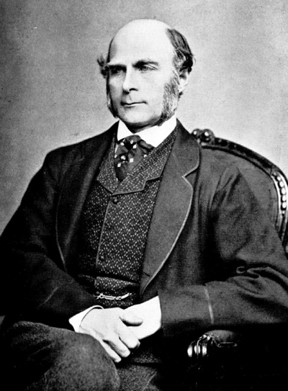
Sir Francis Galton
1822 - 1911 (knighted in 1909)
A pioneer in making predictions
Particular interest in heredity
Charles Darwin's half-cousin
(Demo)

Slide 10
Apply with Multiple Arguments

Slide 11
Apply
The apply method creates an array by calling a function on every element in one or more input columns
First argument: Function to apply
Other arguments: The input column(s)
table_name.apply(one_arg_function, 'column_label')
table_name.apply(two_arg_function,
'column_label_for_first_arg',
'column_label_for_second_arg')
apply called with only a function applies it to each row
(Demo)

Slide 12
Grouping Rows

Slide 13
Group
The group method aggregates all rows with the same value for a column into a single row in the result
First argument: Which column to group by
Second argument: (Optional) How to combine values
len — number of grouped values (default)
sum — total of all grouped values
list — list of all grouped values
(Demo)

Slide 14
Grouping By Two Columns
The group method can also aggregate all rows that share the combination of values in multiple columns
First argument: A list of which columns to group by
Second argument: (Optional) How to combine values
(Demo)

Slide 15
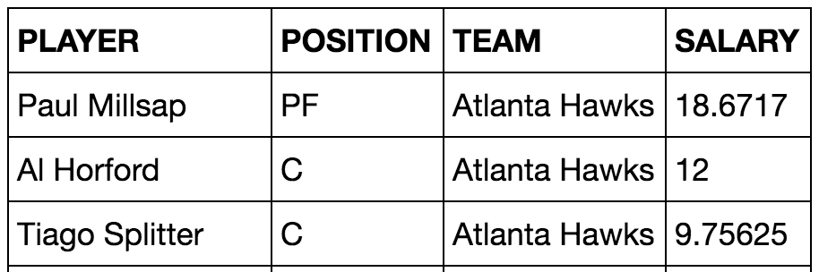
Challenge Question
Which NBA teams spent the most on their starters in 2016?
Each team has one starter per position
Assume the starter for a team & position is the player with the highest salary on that team in that position

Slide 16
Pivot Tables

Slide 17
Pivot
Cross-classifies according to two categorical variables
Produces a grid of counts or aggregated values
Two required arguments:
First: variable that forms column labels of grid
Second: variable that forms row labels of grid
Two optional arguments (include both or neither)
values=’column_label_to_aggregate’
collect=function_with_which_to_aggregate
(Demo)

Slide 18
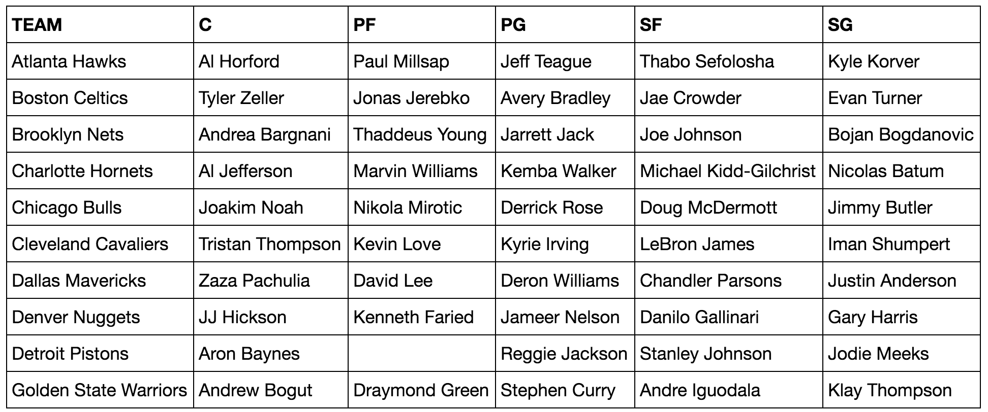
Take-Home Question
Generate a table of the names of the starters for each team

Slide 19
Joins

Slide 20
Joining Two Tables
drinks.join('Cafe', discounts, 'Location')
Keep all rows in the table that have a match ...
… for the value in this column ...
… somewhere in this other table's ...
… column that contains matching values.
drinks
discounts
Drink | Cafe | Price
Milk Tea | Tea One | 4
Espresso | Nefeli | 2
Latte | Nefeli | 3
Espresso | Abe's | 2
Coupon | Location
25% | Tea One
50% | Nefeli
5% | Tea One
Cafe | Drink | Price | Coupon
Nefeli | Espresso | 2 | 50%
Nefeli | Latte | 3 | 50%
Tea One | Milk Tea | 4 | 25%
Tea One | Milk Tea | 4 | 5%
The joined column is sorted automatically
(Demo)

Slide 21
Bikes

Slide 22
Maps

Slide 23
Maps
A table containing columns of latitude and longitude values can be used to generate a map of markers
_______.map_table(table, ...)
Either Marker or Circle
Column 0: latitudes
Column 1: longitudes
Column 2: labels
Column 3: colors
Column 4: sizes
Applies to all features:
color='blue'
size=200

Slide 24
Combining Table Methods

Slide 25
Important Table Methods
t.select(column, …) or t.drop(column, …)
t.take([row, …]) or t.exclude([row, …])
t.sort(column, descending=False, distinct=False)
t.where(column, are.condition(...))
t.apply(function, column, …)
t.group(column) or t.group(column, function)
t.group([column, …]) or t.group([column, …], function)
t.pivot(cols, rows) or t.pivot(cols, rows, vals, function)
t.join(column, other_table, other_table_column)

Slide 26
Discussion Question
Generate a table with one row per cafe that has the name and discounted price of its cheapest discounted drink
drinks
discounts
cheapest
Drink | Cafe | Price
Milk Tea | Tea One | 4
Espresso | Nefeli | 2
Coffee | Nefeli | 3
Espresso | Abe's | 2
Coupon | Location
5% | Tea One
50% | Nefeli
25% | Tea One
Cafe | Drink | Discounted Price
Nefeli | Espresso | 1
Tea One | Milk Tea | 3

Slide 27
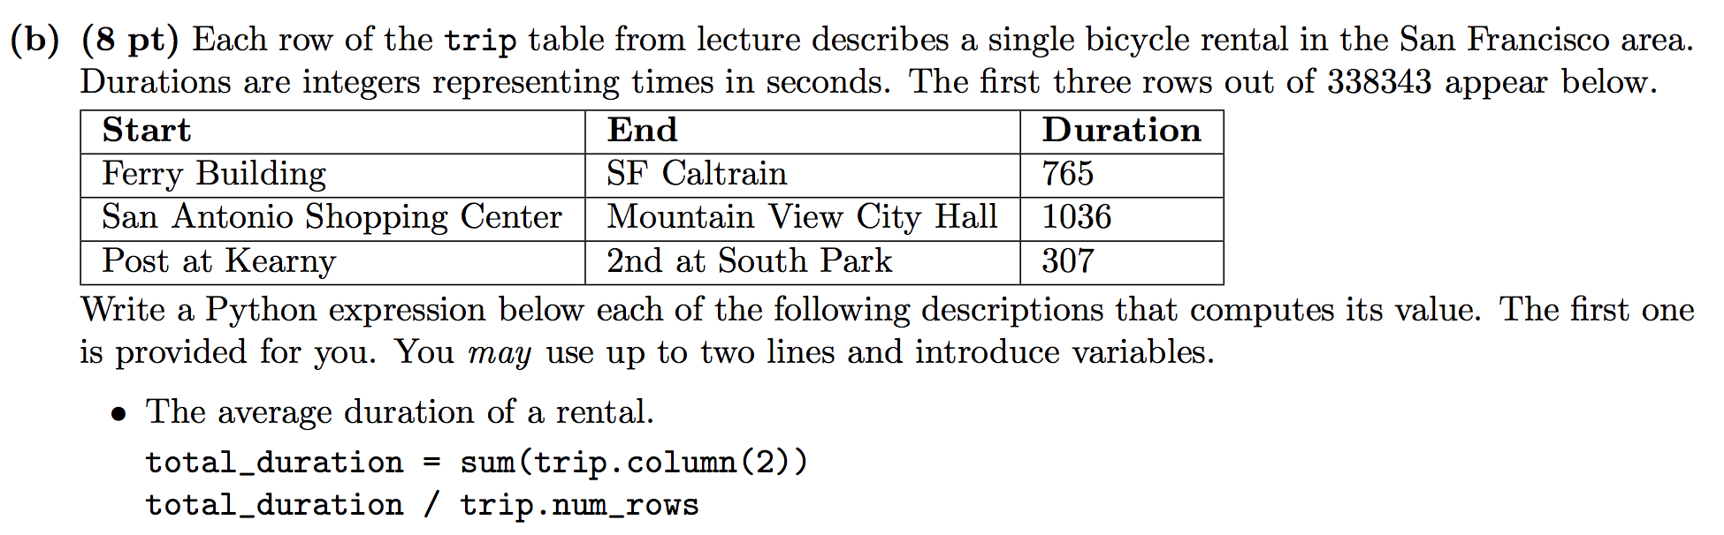
Spring 2016 Midterm, Q2(b)
The name of the station where the most rentals ended (assume no ties).
The number of stations for which the average duration ending at that station was more than 10 minutes.

